Slide 1
IC 242 PROJECT PRESENTATION
TOPIC : KINEMATIC AND DYNAMIC BEHAVIOUR OF FLUIDS
~DEEPAK GUPTA(B20040)
Supervised by : Dr. Mousumi Mukherjee

Slide 2
CONTINUUM MECHANICS IC242
Continuum mechanics is a branch of mechanics that deals with the mechanical behavior of materials modeled as a continuous mass rather than as discrete particles.
The French mathematician Augustin-Louis Cauchy was the first to formulate such models in the 19th century.
This is a general topic for some topic at our level fluid mechanics, strength of material ,structure , soil mechanics etc.

Slide 3
CONTINUUM MECHANICS IC242
The continuity equation describes the transport of some quantities like fluid or gas. The equation explains how a fluid conserves mass in its motion. Many physical phenomena like energy, mass, momentum, natural quantities, and electric charge are conserved using the continuity equations.
The continuity equation provides beneficial information about the flow of fluids and their behaviour during their flow in a pipe or hose. Continuity Equation is applied on tubes, pipes, rivers, ducts with flowing fluids or gases and many more
INTRODUCTION

Slide 4
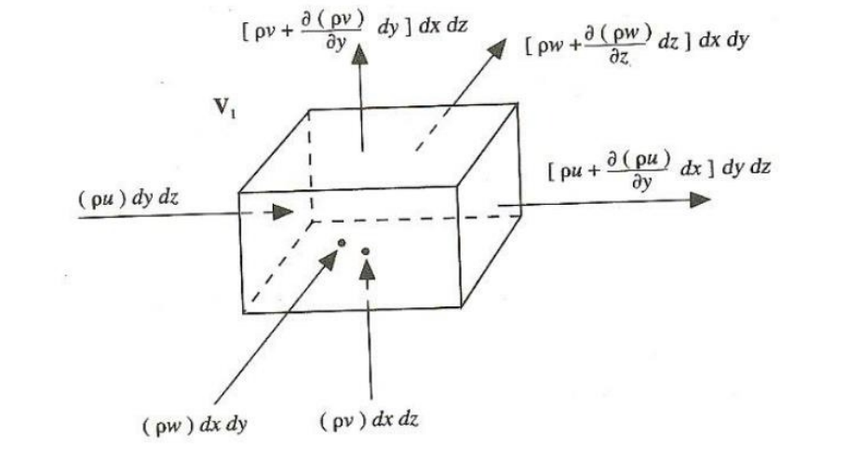
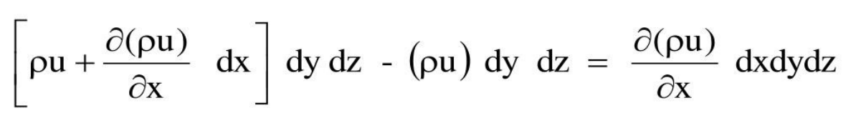
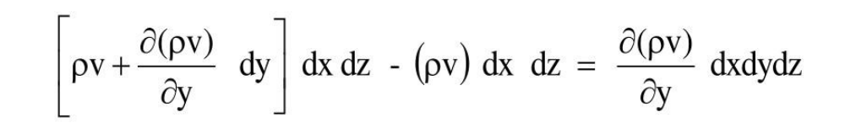
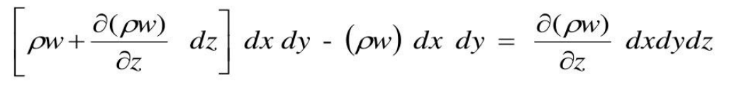
CONTINUUM MECHANICS IC242
CONTINUITY EQUATION
Net outflow in x-direction
Net outflow in y-direction
Net outflow in z-direction

Slide 5
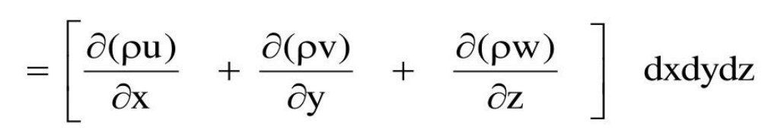
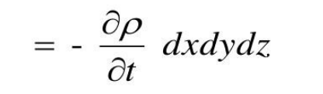
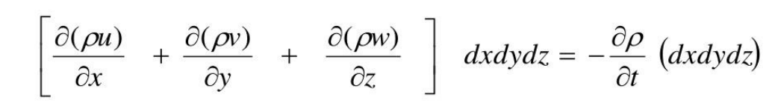
CONTINUUM MECHANICS IC242
Net mass outflow of the element
Time rate of mass decrease in the element
Net mass outflow of the element = Time rate of mass decrease in the control environment

Slide 6
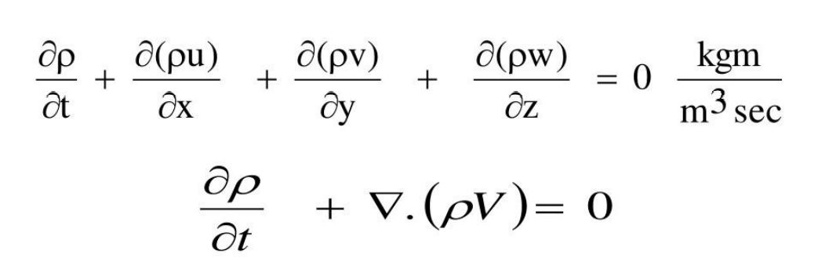
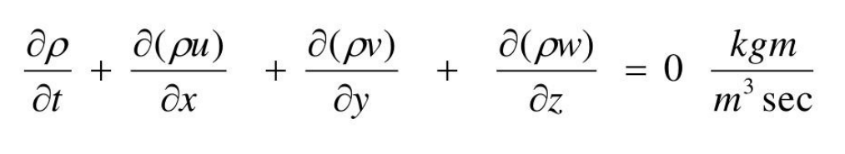
CONTINUUM MECHANICS IC242
The above equation is a partial differential equation form of the continuity equation. Since the element is fixed in space, this form of equation is called conservation form.

Slide 7
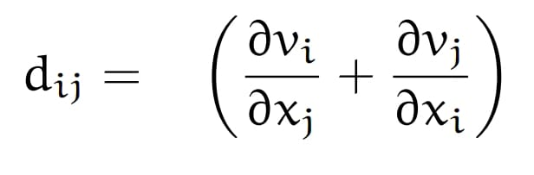
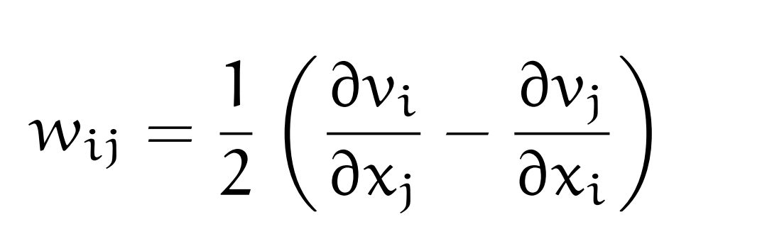
CONTINUUM MECHANICS IC242
Important points that we can see in continuity equation
For incompressible flow
∇⋅v=0
Angular deformation
Rate of deformation tensor or average rate of rotation
Angular velocity
=1/2 (∇×v)​​

Slide 8
CONTINUUM MECHANICS IC242
THANK YOU

